Slide 1
Papyrus Notifications

Slide 2
Needs
Global Look and feel for the notifications to users
Express the « what » and not the « how »

Slide 3
Needs
Express an asynchronous notification
  It’s not necessary to stop the work of the user
  Example
    “It’s not possible to do this action”
    “A resource is not loaded do you want to load it ?”
Express a synchronous notification
  →The information is necessary

Slide 4
Solution
Notification Builder
  Class able to create notifications
  Define parameters
    ➔ the correspondent display is chosen

Slide 5
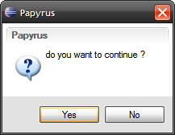
Solution
Currently 3 different ways (look and feel can evolve):
  Popup
  Example
    Your action will delete “XXX” are you sure ?

Slide 6
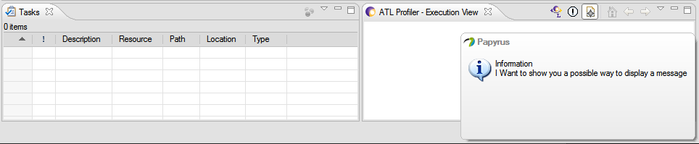
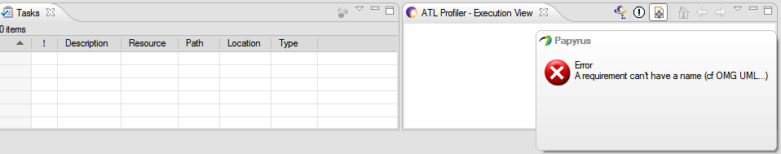
Solution
Temporary Popup

Slide 7
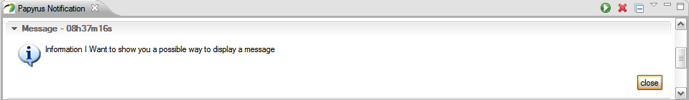
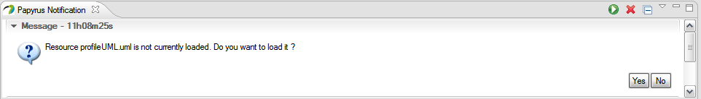
Solution
Notification View
  The view displays a list of notifications
Expand/Collapse all the messages
Run all the default actions (first ones)
Cancel all the messages (just close)

Slide 8
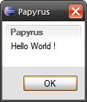
Notification Builder
API
  Hello World :
    new NotificationBuilder().setMessage("Hello World !").run();
  public NotificationBuilder setMessage (String message) ;
    The notification will display the message “message”
  public NotificationBuilder setAsynchronous (boolean asynchronous)
    Define if the notification is Asynchronous (ie if the notification blocks the user or not)
  public NotificationBuilder addAction (NotificationRunnable runnable)
    Add an action to the notification, a runnable is associated to a button. The first is the default one
  public NotificationBuilder setComposite (ICompositeCreator creator)
    If the developer wants to customize the composite inside the notification he can provide an ICompositeCreator instance
  public NotificationBuilder setDelay (long delayMs)
    How long the notification is displayed
  public NotificationBuilder setTemporary (boolean temporary)
    Set if the notification is temporary or not
  public NotificationBuilder setTitle (String title)
    Define a title for the notification
  public NotificationBuilder setHTML(boolean useHTML)
    Define if the content of the message is HTML
  public NotificationBuilder setType(Type type)
    Define a type for the notification (INFO, WARNING, ERROR, QUESTION)
  public NotificationBuilder setImage(Image image)
    Define an image to display in the notification
  public NotificationBuilder setBuilderClass(Class<? extends IBuilder> builderClass)
    Force a builder class

Slide 9
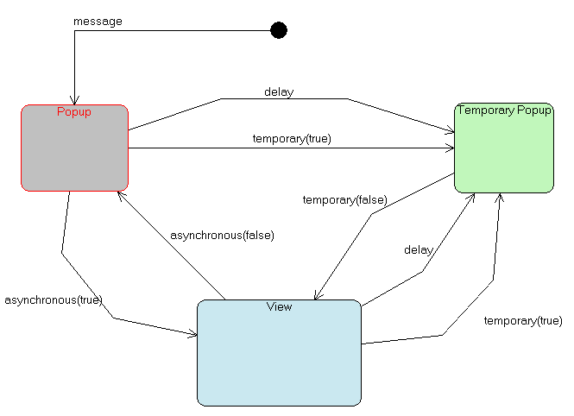
Notification Builder

Slide 10
Notification Builder
Static methods for Notification creation
  public static NotificationBuilder createInformationBuilder()
  public static NotificationBuilder createAsyncPopup (String text)
  public static NotificationBuilder createAsyncPopup (String title, String text)
  public static NotificationBuilder createInfoPopup (String text)
  public static NotificationBuilder createWarningPopup (String text)
  public static NotificationBuilder createQuestionPopup (String text)
  public static NotificationBuilder createErrorPopup (String text)
  public static NotificationBuilder createYesNo (String message, final Runnable yes, final Runnable no)
  →call the static method and do « run »

Slide 11
Other point
If the developer doesn’t want to use NotificationBuilder
  Can reuse components for subclassing !
    ➔ global look and feel for papyrus

